Slide 1
CSE 211
Digital Design
Combinational Logic: Binary Adders, Binary Multiplier

Slide 2
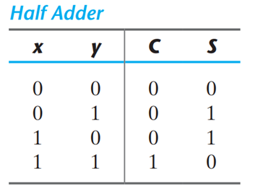
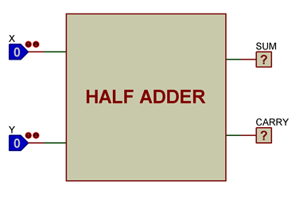
Half Adder
S = x’y + xy’
C = xy

Slide 3
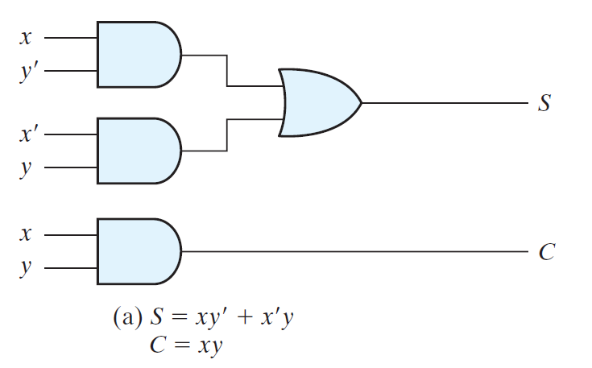
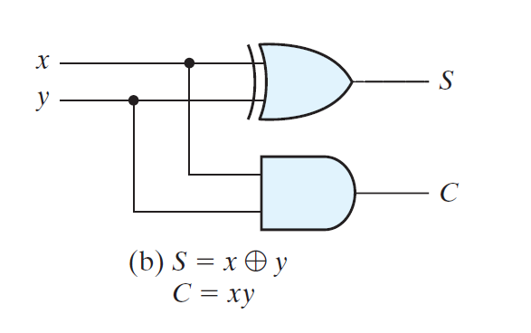
Half Adder

Slide 4
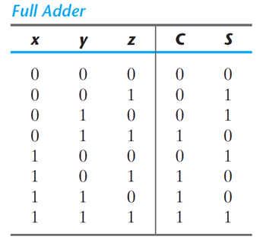
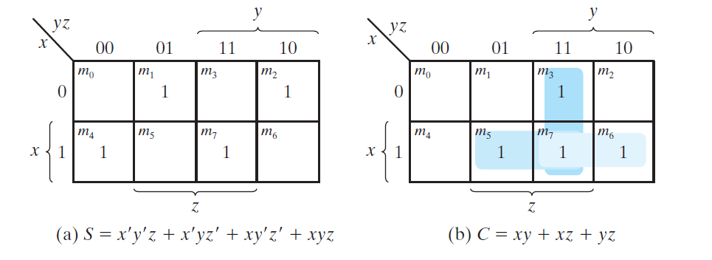
Full Adder
S = x’y’z + x’yz’ + xy’z’ + xyz
C = xy + xz + yz

Slide 5
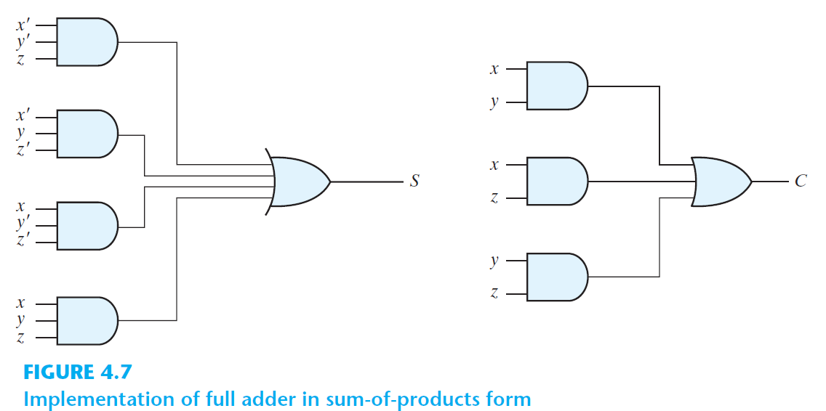
Full Adder

Slide 6
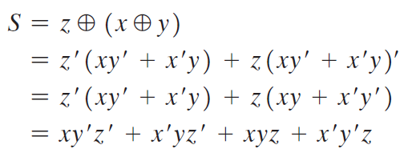

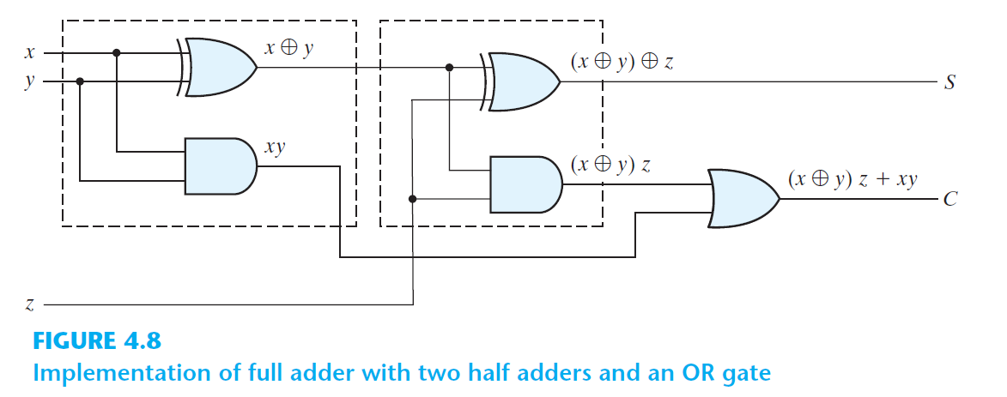
Full Adder

Slide 7
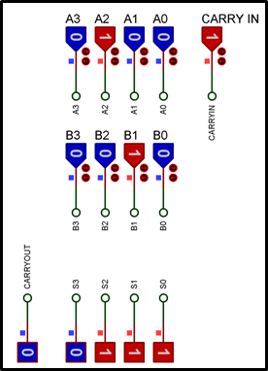
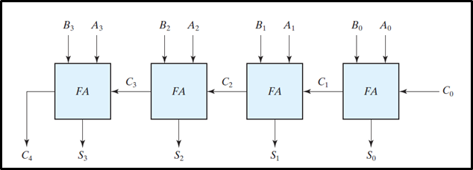
Exercise
Design a 4-bit adder circuit base on the figure below.
The components you need to use;
●74LS83 : 4 bit binary full adder component

Slide 8
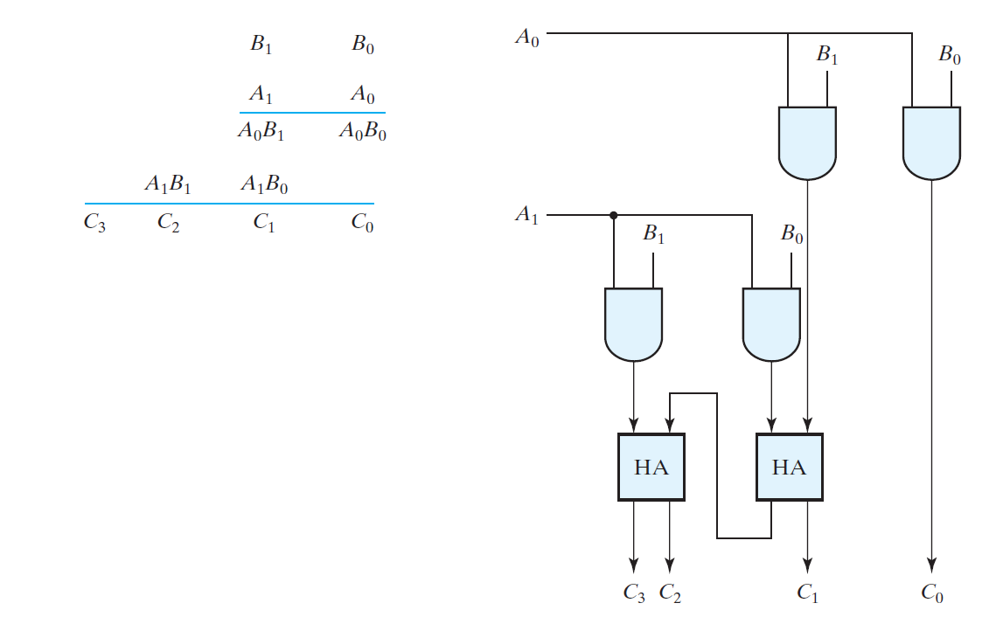
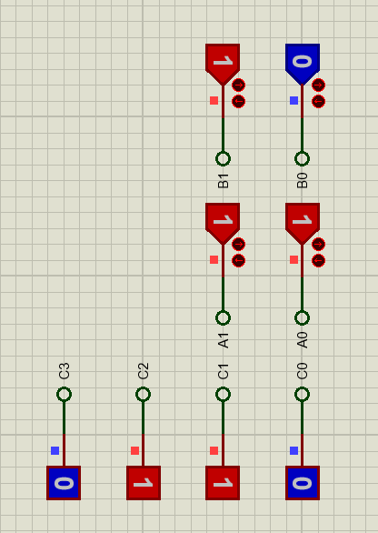
Binary Multiplier

Slide 9
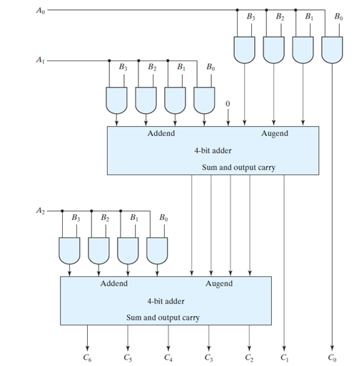
Assignment Four-bit by three-bit binary multiplier
Design a Four-bit by three-bit binary multiplier on Proteus Design Suite that multiplies
3-bit binary number A0,A1,A2 and
4-bit binary number B0,B1,B2,B3.
Consider the following figure while designing
The components you need to use;
●74LS83 : 4 bit binary full adder component

